Slide 1
Forecasting the Seattle (King Co.)
Housing Market
Andy Klatt
August 3, 2023
ECON 513 – Economic Modeling and Forecasting
MSQE Capstone C #4

Slide 2
Motivation
Why forecast Seattle (King County) real estate?
Residential real estate is often the largest and most important investment a consumer will make
Owning Real Estate is the most traditional path to wealth and social mobility
  The more unaffordable housing becomes the great the inequality gap
Forecasts can help buyers and sellers to understand where the market is moving, what action to take and when
  Can also help inform cost of living proxies for wages
Few analysts choose to release public forecasts at the metro-area level. They can be purchased, however.
  Seattle has shown to be unique in it’s accelerated growth the last 15 years
It’s personal!

Slide 3
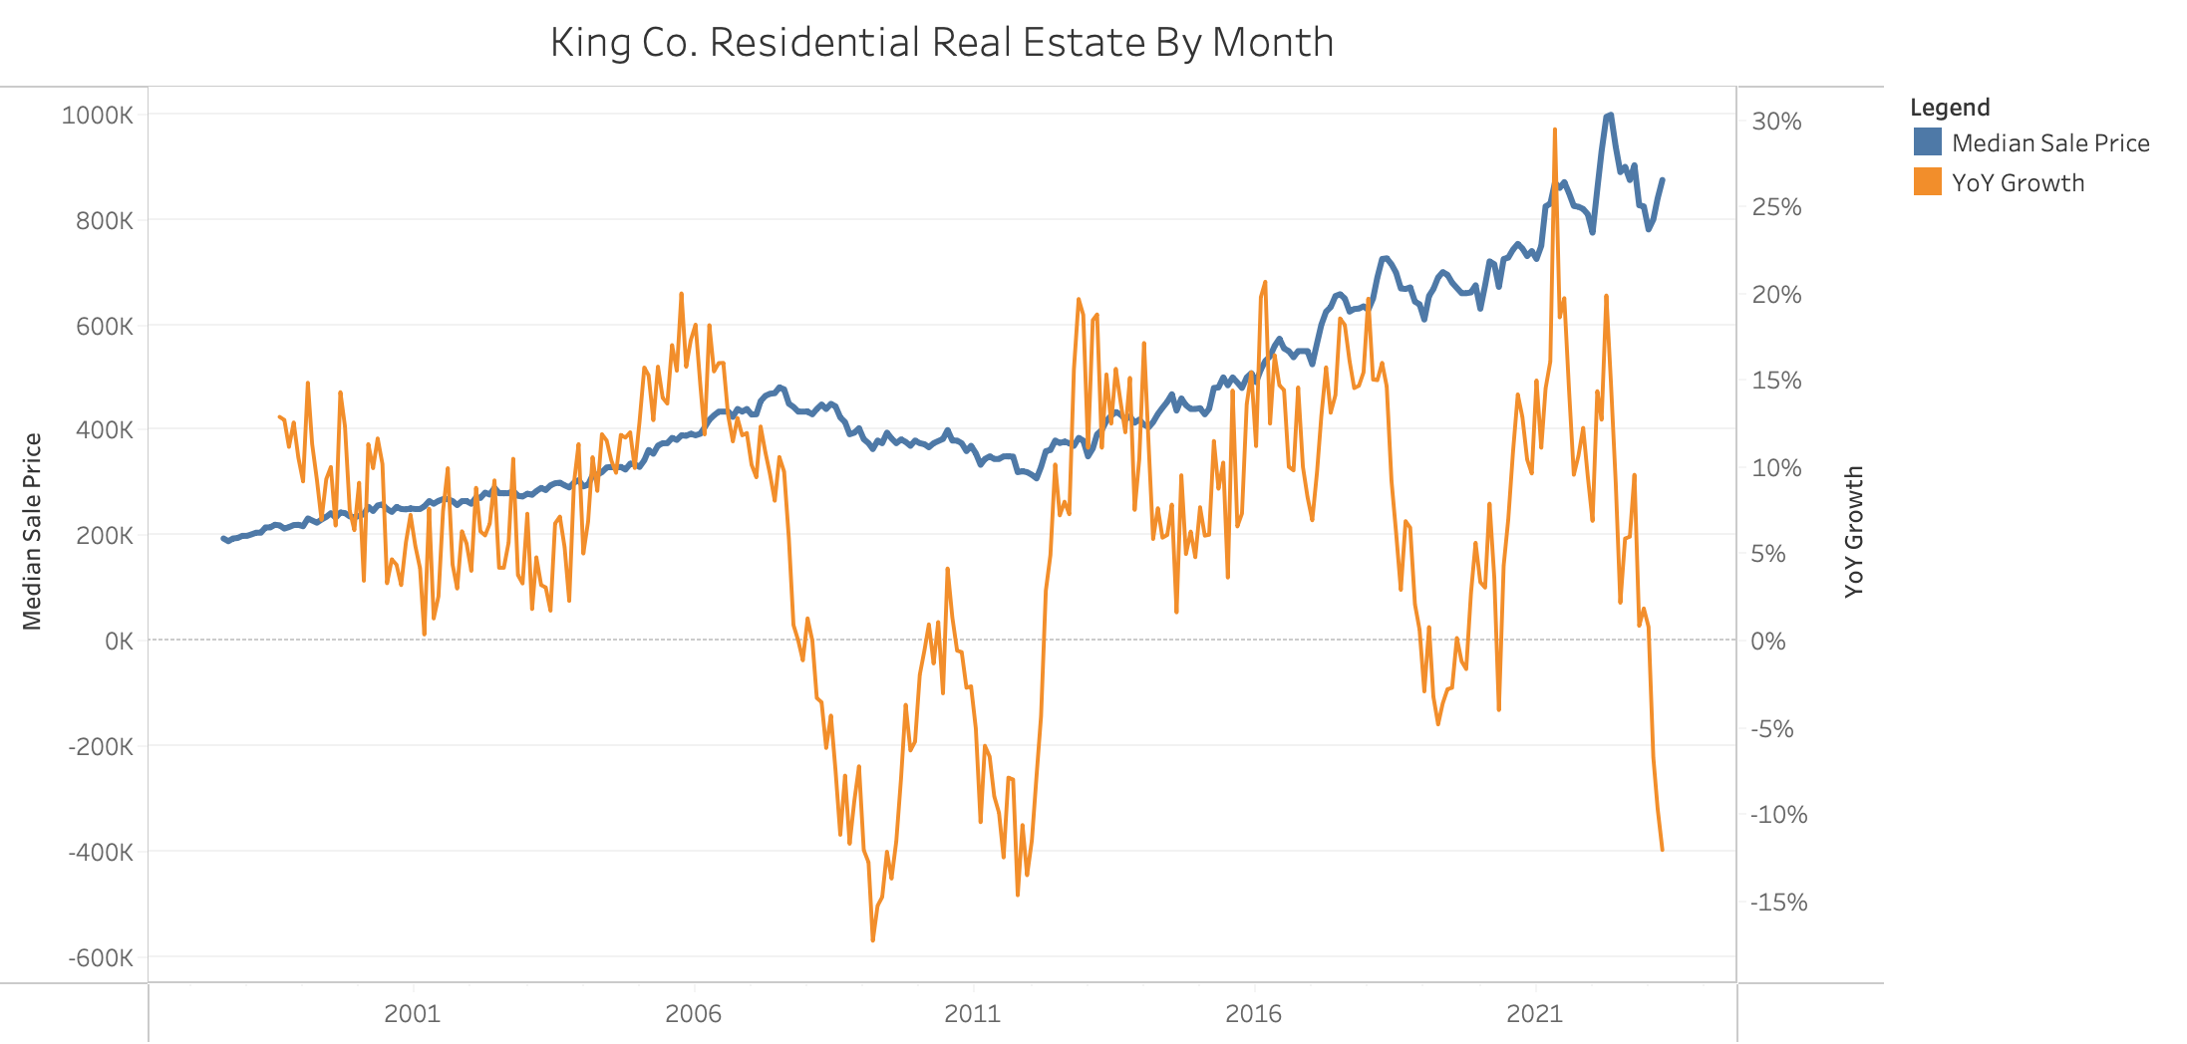
Single Family Home - Median Sale Price

Slide 4
Data
Used in Regressions

Slide 5



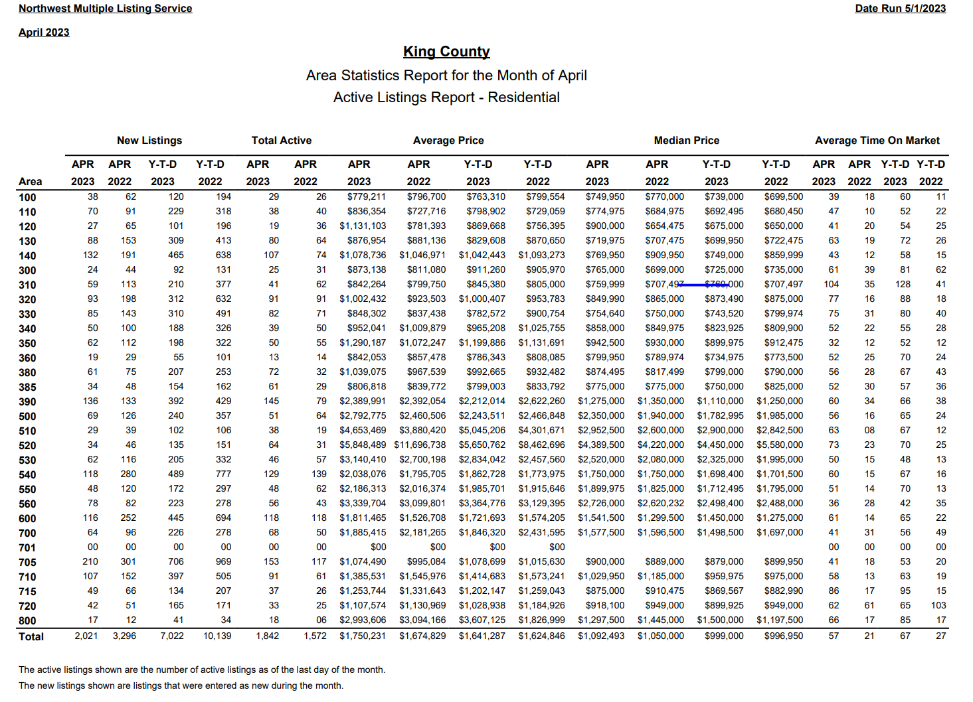

Data Prep
NWMLS Real Estate Data… 308 monthly PDFs to .CSV
Other Data Prep:
Interpolated (roughly) local sub-prime mortgage originations based on Fed data.
Back-casted housing stock and education data (not used)
Weighted average of AMZN, MSFT, BA stock data
Seattle CPI numbers every other month
  Linear interpolation
Tabula
Tableau Prep
Excel
1/3 manual entry.
PDFs got inconsistent < 2006
Special thanks Danny Greco!

Slide 6
Stochastic Properties of KDV
Median Sale Price
Number of Active Listings
 | ACF (1) | ADF Unit Root Test Statistic Null = non-Stationary | DF-GLS Unit Root Test Statistic Null = non-Stationary | KPSS Unit Root Test Statistic Null = Stationary
Levels | 0.98 | 1.25 | -0.28 | 4.15***
First Difference | 0.253 | -2.477 | 1.638* | 0.128
Second Difference | -0.467 | 14.351*** | 0.29 | 0.026
First & Seasonal Difference (ΔΔ¹²) | -0.05 | -3.37** | -3.31*** | 0.161
I(0), I(1), or I(2)? | I(1) | I(1) | I(1) | I(1)
Seasonal Lags | >6 years | >6 years | >6 years | >6 years
 | ACF(1) | ADF Unit Root Test Statistic Null = Non-Stationary | DF-GLS Unit Root Test Statistic Null = Non-Stationary | KPSS Unit Root Test Statistic Null = Stationary
Levels | 0.979 | -1.976 | -1.542 | 2.665***
First Difference | 0.557 | -4.183*** | -2.83*** | 0.45*
First & Seasonal Difference (ΔΔ¹²) | 0.51 | -6.16*** | -1.71* | 0.03
I(0), I(1), or I(2)? | I(1) | I(1) | I(1) | I(1)
Seasonal Lags | >6 years | >6 years | >6 years | >6 years
*** p<.01 ; ** p < .05 ; * p < .10
Notes:
2 OUT 3 TESTS PASSED AT First Differenced. Showing evidence that both Median Sale Price and Number of active listings is I(1)
I also did a seasonal difference to show it is stationary there.
Second differencing of KING_PMED shows over-differencing

Slide 7
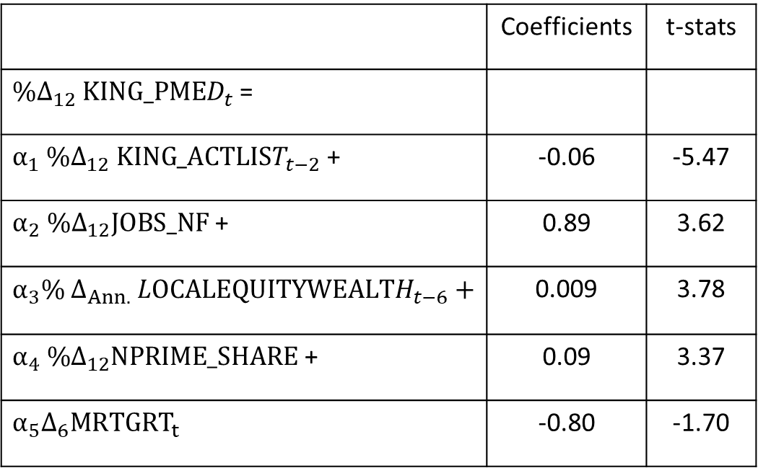
Median Home Price: Regression
 | Coefficients | t-stats
$\%Δ_{12} KING_PMED_{t}$ =
$α_{1} \%Δ_{12} KING_ACTLIST_{t−2}$ + | -0.06 | -5.47
$α_{2} \%Δ_{12}JOBS_NF$ + | 0.89 | 3.62
$$α_{3}\% Δ_{Ann.} LOCALEQUITYWEALTH_{t−6}+$$ | 0.009 | 3.78
$α_{4} \%Δ_{12}NPRIME_SHARE$ + | 0.09 | 3.37
$$α_{5}Δ_{6}MRTGRT_{t }$$ | -0.80 | -1.70
Estimation Technique Least Squares (NW)
Data Frequency Monthly
Estimation Range Dec 1998 to April 2023
Net d.f. 287 (i.e. 293-5)
Resid Unit root test N/A (differenced DV)
Residuals ACF(1) 0.755
Seasonal Dummies N/A
Notes:
Perhaps what may be missing is some variable on housing stock or housing stock relative to population

Slide 8
Median Home Price: Interventions
Pre-intervention – Final Model
 | Largest Sigma Size in Time Period | Time Period
Shock #1 | -3.2 sigma (2011:10) | Winter 11/12: 2011:10 - 2012:03
Shock #2 | -1.6 sigma (2008:10) | Great Recession 07/08/09: 2007:12 -2009:06
Shock #3 | 1.71 sigma (2022:10) | Post-Covid Year 2 22/23: 2022:04 – 2023:03
Post Intervention – Robustness Check (Interventions not in Final Model)
 | Largest Sigma Size in Time Period | Time Period
Shock #1 | -0.47 sigma (2011:10) | Winter 11/12: 2011:10 - 2012:03
Shock #2 | -1.07 sigma (2008:10) | Great Recession 07/08/09: 2007:12 -2009:06
Shock #3 | 1.19 sigma (2022:10) | Post-Covid Year 2 22/23: 2022:04 – 2023:03
test

Slide 9
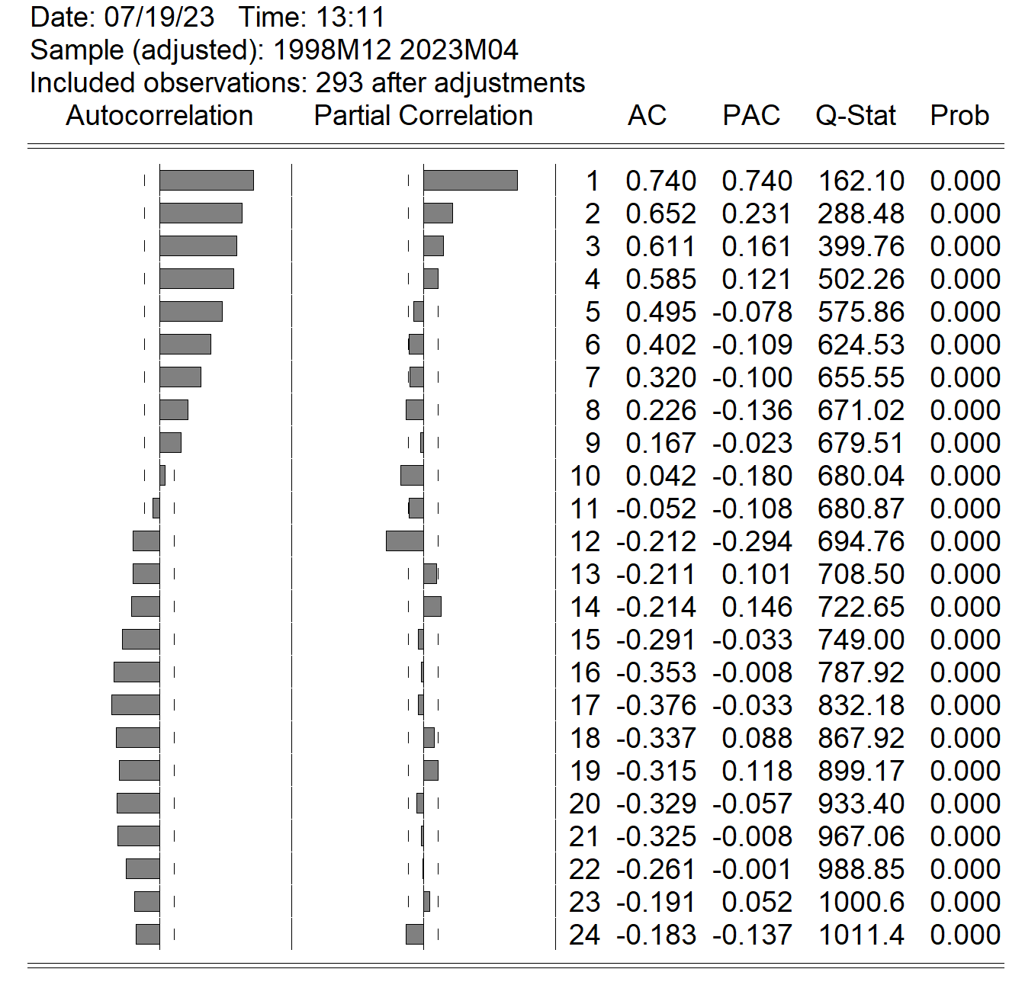
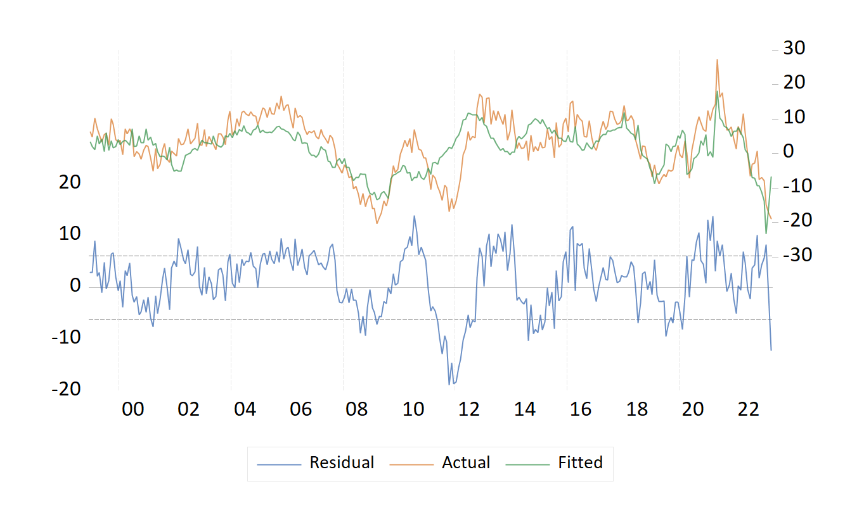

Structural Regression - Median Home Price
Dependent Variable: % ${\text{Δ}}_{12}$ Median Home Price
Notes:
There was a unit root test done on these residuals and they passed the ADF test showing evidence of non-stationarity of residuals.

Slide 10
Median Home Price: Regression
Causality Statements
Number of Active Listings - When there is more inventory, buyers have more choices and prices will decline.
Non-Farm Jobs – When more jobs are created, income becomes more stable, there will be more demand for housing and prices will rise.
Local Equity Wealth – Many home-buyers will use stored equity that they may have received in the form of employee stock grants. The higher the stock prices for the large local corporations will result in higher demand and higher prices.
Non-Prime Mortgage Originations – When more home-buyers can afford home via sub-prime mortgages, prices will rise as more people can afford homes through loose credit.
Mortgage Rate - When mortgage rates rise buyers are priced out of the market due to the increased cost of credit and home prices will fall
REGRESSION SUMMARY: Assume COVID-related shocks do not need to be modeled going foward

Slide 11
Structural Model Flowchart
NPRIME
LEW
JOBS_NF
MRTGRT$
MRTGRT
XCPIU
KING_PAVE$
KING_PMED$
KING_ACTLIST
KEY:
LEW = LOCALEQUITYWEALTH
NPRIME = NPRIME_SHARE
KING_PAVE
KING_PMED
KING_SOLD
EXOGENOUS
C_SEA_XCPIUAH
STOCHASTIC
IDENTITY
KING_SOLD_VOLUME

Slide 12
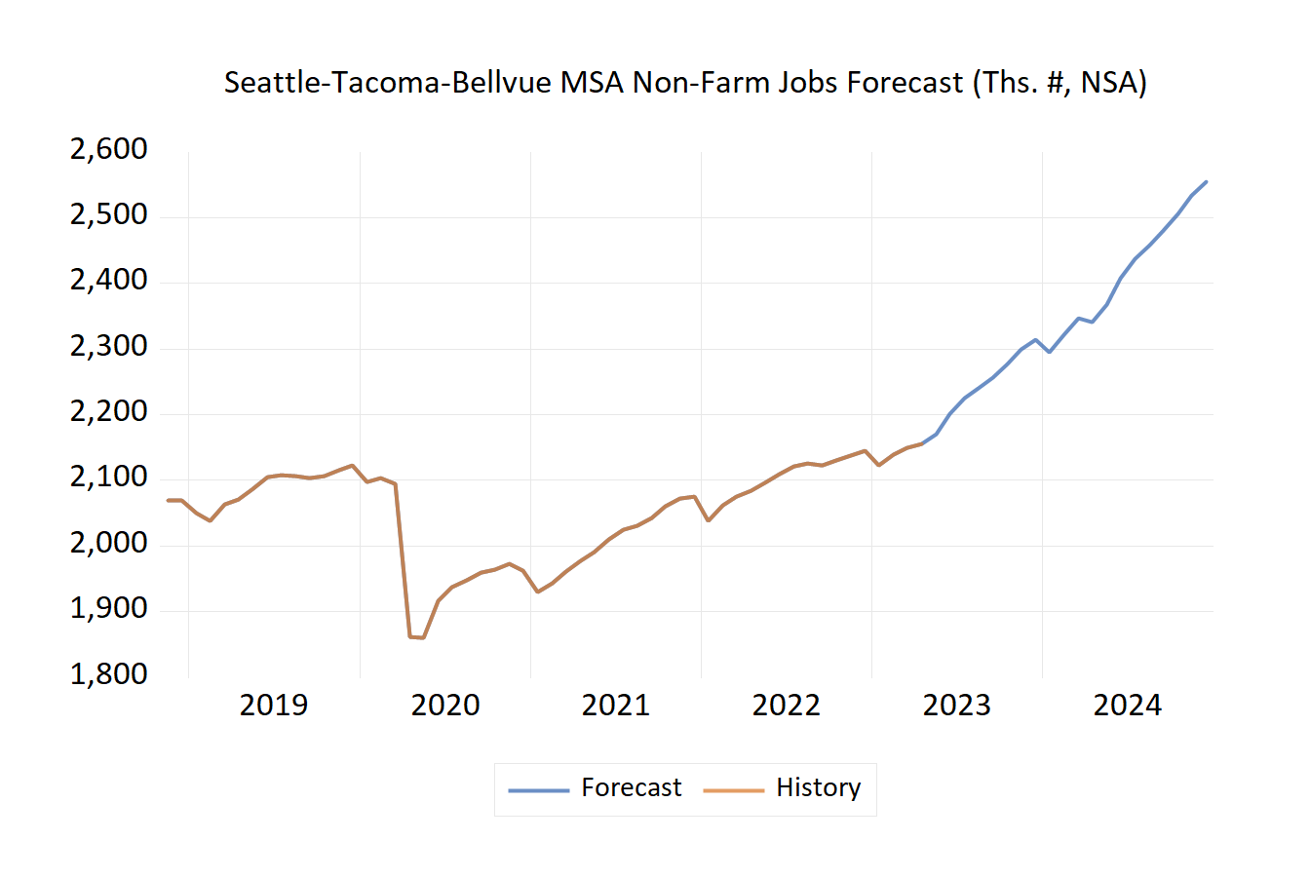
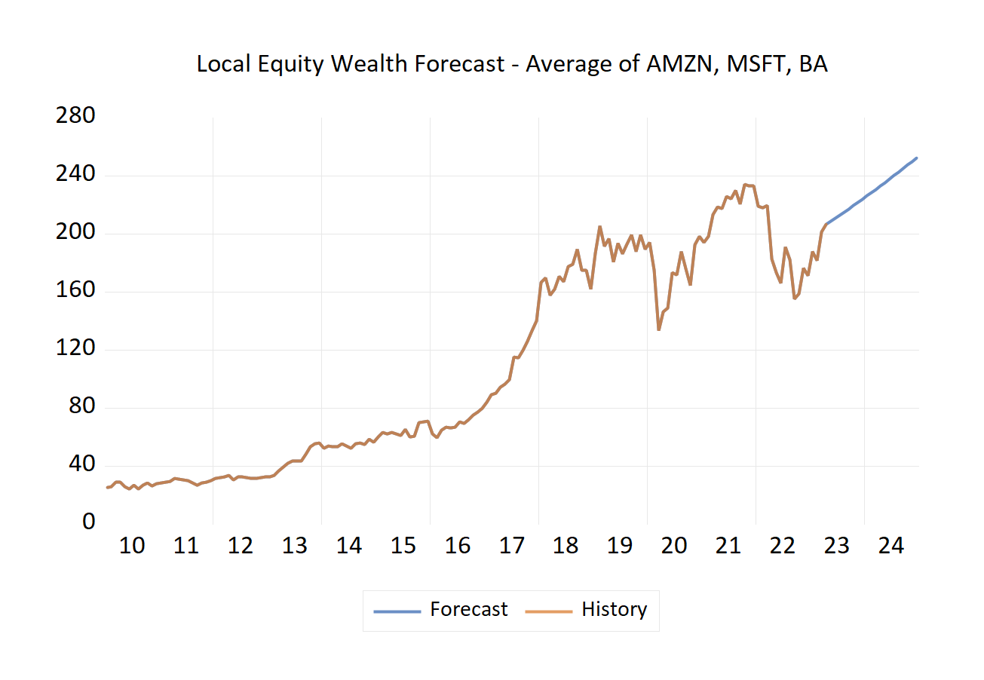
Exogenous Variable Forecasts
ARIMA Forecasts In-Support of Structural Model

Slide 13
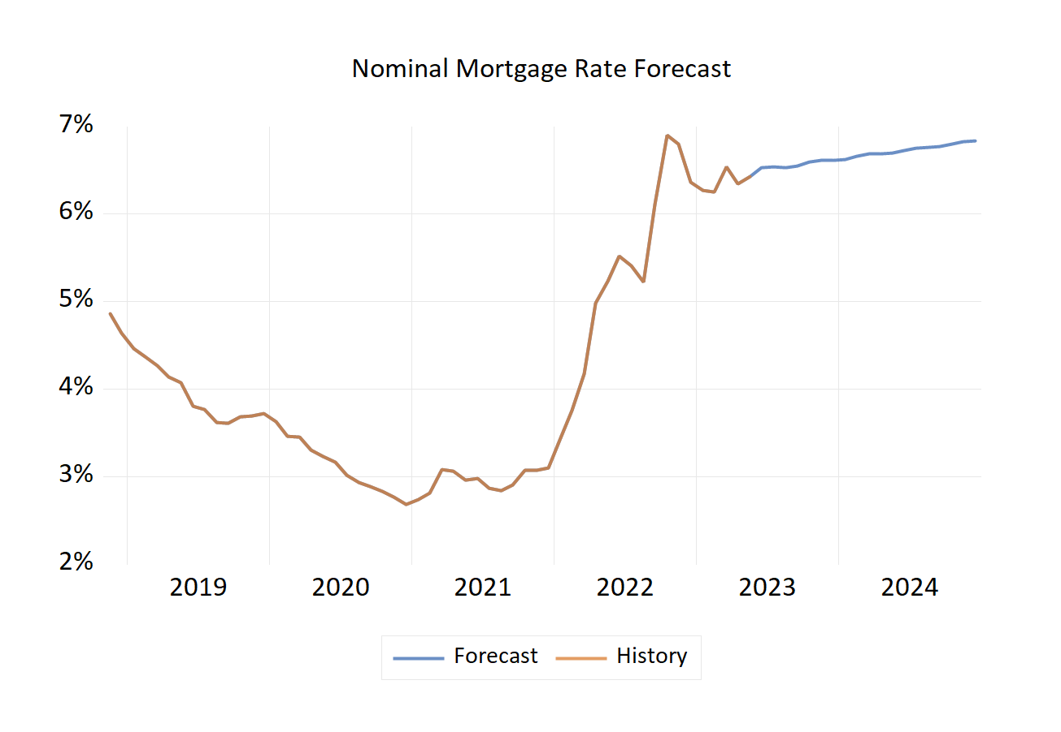
Exogenous Variable Forecasts
ARMIA Forecasts In-Support of Structural Model

Slide 14
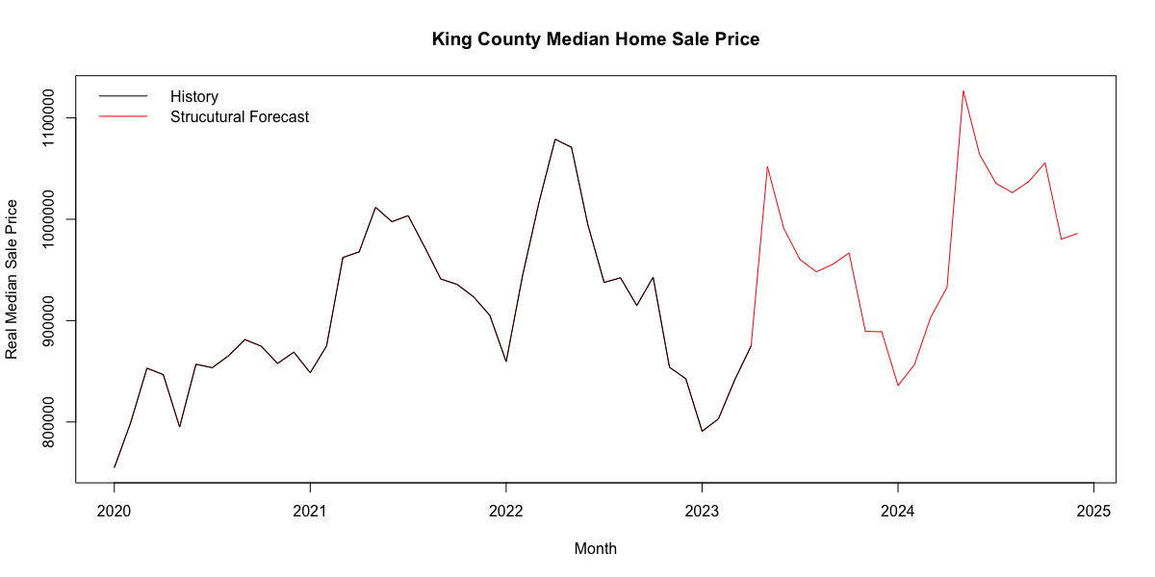
Structural Forecast – Median Home Price
Notes:
Structural is very optimistic that the accelerated growth the past 15 years will continue
Both VAR and my subjective predict the correction continues in 2023 and modest growth in 2024.
The large positive sign on the jobs exogenous variable appears to be influencing this positive outlook.
We exogenously forecast jobs to continue to rise and the model sees that as overcoming other influences like rising mortgage rates.

Slide 15
VAR Specification for Competing Forecast
Endogenous: KING_PMED$, KING_ACTLIST
Exogenous: MRTGRT$, INCPERCAP, NF_JOBS, POST_COVID_2YR
 | Stable (Y/N) | Estimation Lag Length Used | Variable in Levels, Differenced | Number of Estimated Parameters - % of Obs
Estimated VAR | Yes! | 24 | Endogenous Variables are First & Seasonally Differenced D(x,1,12) | 2+(24)(2^2) + 4 = 102 33% of Obs
 | LR | FPE | AIC | HQ
Lag Length Criteria Results | 45 | 24 | 24 | 1
Notes:
Much like structural took our KDV to be endogenous
mortgage rates jobs, income per capita, and an intervention variable to be exogenous
VAR was estimated to be stable at 24 lags.
The lag length of 24 was found to be optimal for 2 of the four lag length criteria assessed.
The number of pararameters estimated is high at around 1/3 of our observations.

Slide 16
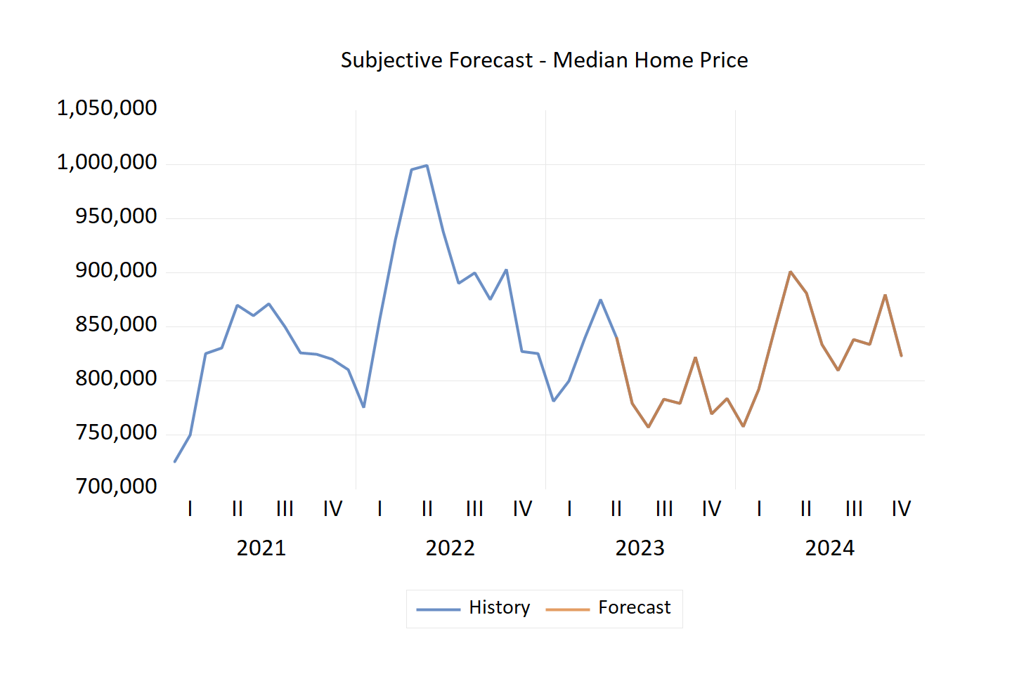
Subjective Forecast – Median Home Price
Mortgage rates are high, will remain high
  Fed has penciled in one more rate hikes in 2023
  Supply will continue to be suppressed
  Pent up supply will release as high rates become persistent
Job Growth, income, stock market still strong
  Despite layoffs in early 2023
  Assumes a “soft landing” or ”no landing” (at least in Seattle) after 2023 correction.

Slide 17
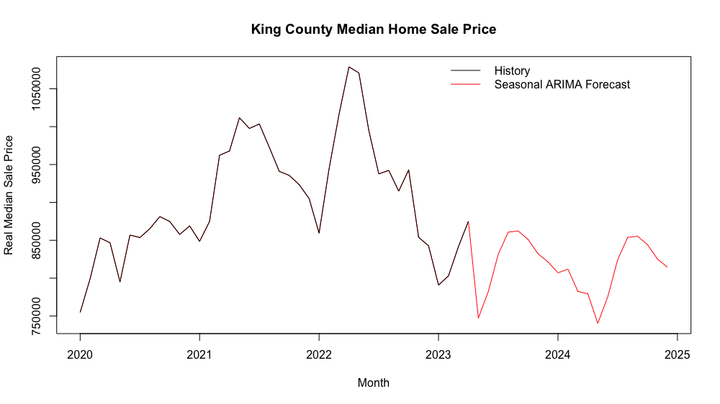
ARIMA Model For KING_PMED$: (1,1,1) + (0,1,1)
Notes:
No intervention variables. The in sample errors were not that large when not using an IV.
We seem similar pattern to both the subjective that growth will flatten for the next year and a half.

Slide 18
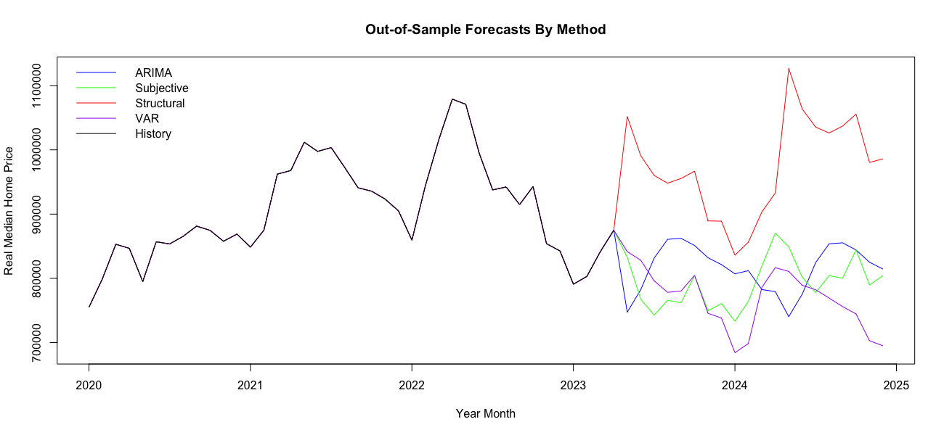
Median Home Price OOS Forecasts Comparison
Notes:
Structural is very optimistic that the accelerated growth the past 15 years will continue
Both VAR and my subjective predict the correction continues in 2023 and modest growth in 2024.
The VAR shows a stead decline for the rest of 2023
ARIMA is somewhat more bullish then VAR and subjective

Slide 19
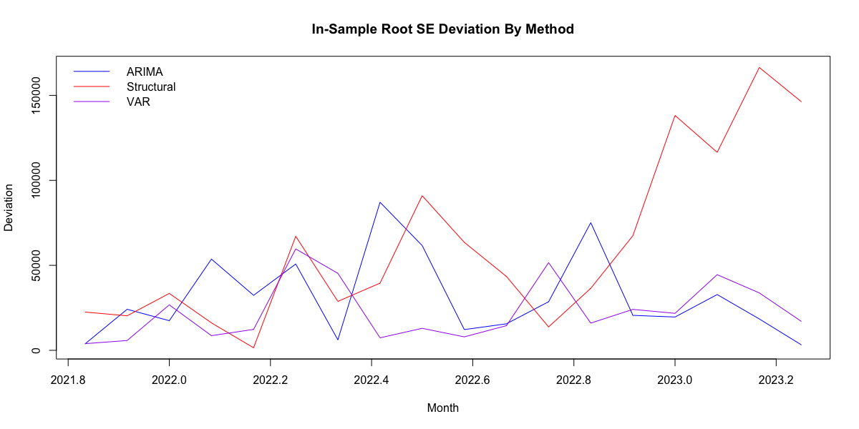
Median Home Price – IS Root SE Errors
Notes:
Structural is likely off because I didn’t use an intervention variable

Slide 20
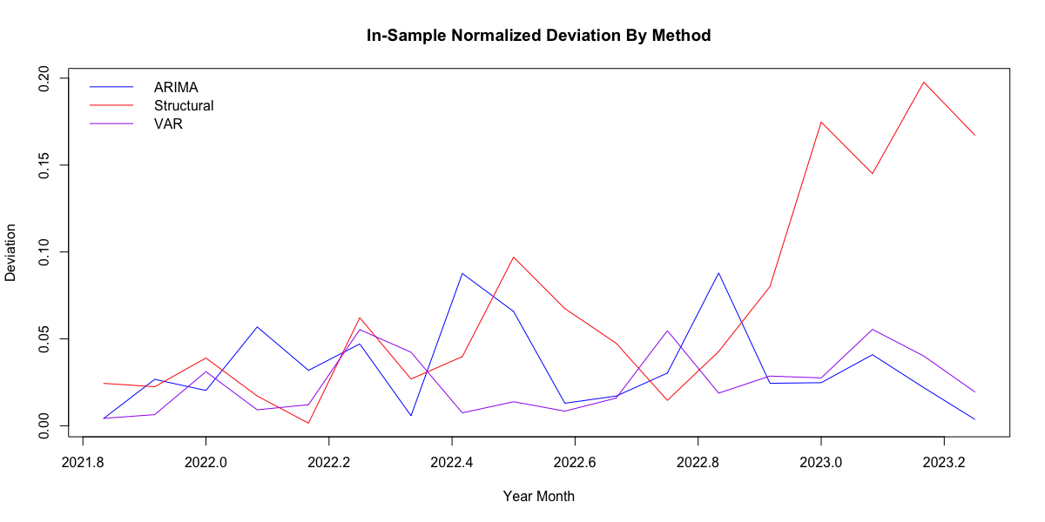
Median Home Price – IS APE Errors
Notes:
We see a similar pattern for MAPE

Slide 21
IS RMSE Analysis
METHOD RMSE Equal Optimal #1* Optimal #2*
ARIMA 39,385 33.3% 39.8% 26.9%
Structural 78,597 33.3% 13.0% 29.2%
VAR 28,361 33.3% 47.3% 43.9%
COMBINATIONS
Equal Weight 41,343
Optimal Weight #1 32,322
Optimal Weight #2 38,853
*Rounding is why these don’t sum to 1.0
Notes:
The equal weights were revised based on each method’s contribution to the sum of all the RMSE(s). If a method had a greater error share this implies a worse forecast performance.
The optimal share for such a method would be adjusted down from equal weight by the same excess error contribution amount.
Example: if the RMSE contribution was 25%, the equal weight 33% would be adjusted up by 8% to 39%.
The second optimal weight was done by thaking the three months that have passed since data collection and doing a similar error share analysis and weighting.
Sio instead of using the IS range I used the range of May-July 2023. Came close to equal weighting.
Most performed pretty similarly on the IS range being off by about 40k
Optimal weighting 1 performed better on IS which makes sense bc it was modeled based on it

Slide 22
IS MAPE Analysis
METHOD MAPE Equal Optimal #1* Optimal #2*
ARIMA 3.3% 33.3% 40.5% 31.1%
Structural 7.0% 33.3% 12.2% 29.5%
VAR 2.5% 33.3% 47.3% 39.4%
COMBINATIONS
Equal Weight 4.0%
Optimal Weight #1 3.1%
Optimal Weight #2 3.8%
*Rounding is why these don’t sum to 1.0
Notes:
The equal weights were revised based on each method’s contribution to the sum of all the RMSE(s). If a method had a greater error share this implies a worse forecast performance. The optimal share for such a method would be adjusted down from equal weight by the same excess error contribution amount. Example: if the RMSE contribution was 43%, the equal weight 33% would be adjusted down by 10% to 23%.
Optimal weighting 1 performed better on IS which makes sense bc it was modeled based on it
Again weighting performed similarly on IS

Slide 23
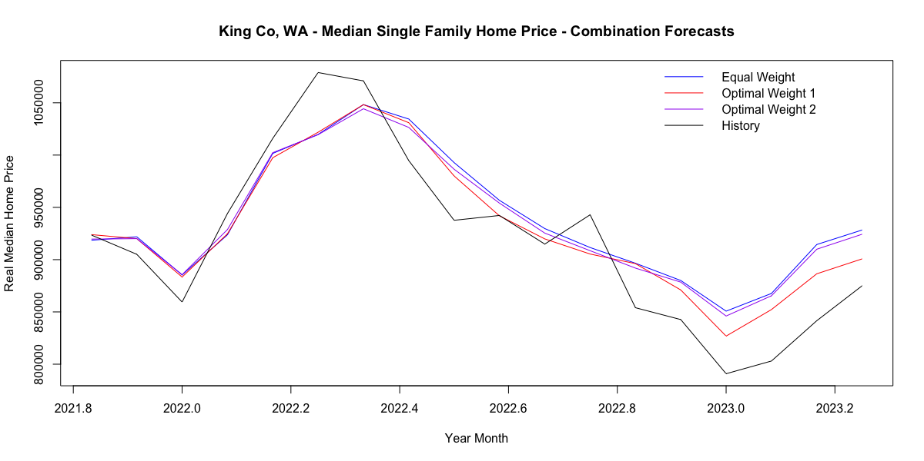
In-Sample Combination Forecasts (RMSE)
Optimal weights use RMSE weighting.
Notes:
Somewhat surprised to see that all weighting schemes when visualized seem prett close to one another when looking at IS range. WE saw the

Slide 24
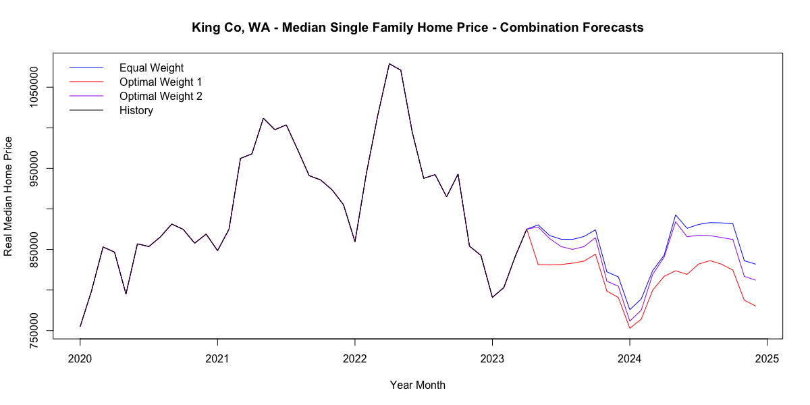
Out-of-Sample Combination Forecasts
Optimal weights use RMSE weighting.
Notes:
All combos predict a decline in sale price bottoming out near the turn of the cal year. Then returning for flat growth in 2024.
Equal weight is most bullish, followed by optimal 1 and optimal 2 which is based on more recent data

Slide 25
Conclusion: In-Sample Error Performance
 | Methods |  |  | Combinations
 | ARIMA | VAR | Structural | Equal Wt | Optimal Wt #1 | Optimal Wt #2
RMSE | 39,384 | 28,361 | 78,597 | 41,343 | 32,322 | 38,852
MAPE | 3.4% | 2.5% | 7.0% | 4.0% | 3.1% | 3.8%
Notes:
The VAR actually performs better but probably because it uses an intervention variable for the 2nd year post COVID
Combinations performs similalrly

Slide 26
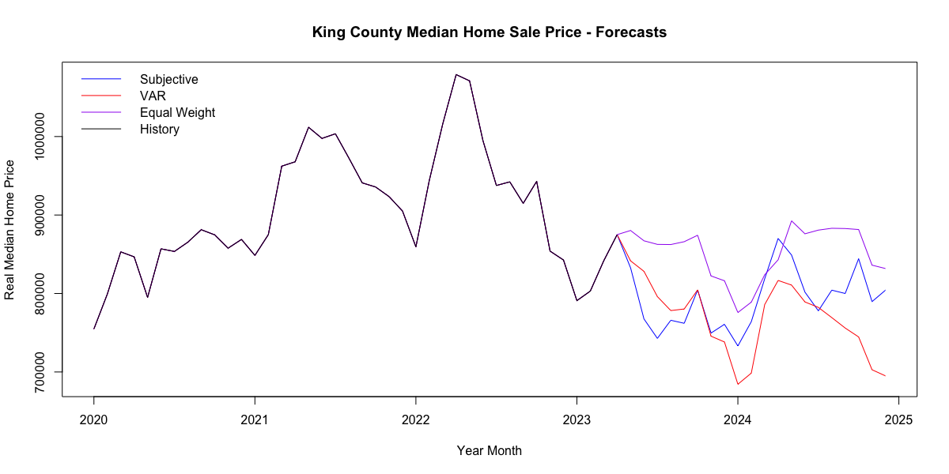
Conclusion: Preferred Forecast
Notes:
Comment on strengths and weakness:
VAR: Takes in to account multi-directional dynamics. Has intervention variable. Best performance of IS
Equal Weight: Empirics tells us this is the best combination. Don’t try and beat it. Incorporated the optimistic structural.
Subjective: Incorporates my gut thinking. But the weights I used were not too sophisticated and highly dependent on recent history and just using different scalars.

Slide 27
Potential Improvements (Low Effort)
Robustness check: VAR without intervention variable
  Effect on IS Error? Similar to Structural?
Incorporate an “unaffordability” RHS variable to the Active Listings Structural Regression: median home price / median income.
Proof-read and code review.

Slide 28
Potential Improvements (High Effort)
Create a better structural specification for inventory.
Explore the dynamics of housing stock and/or permits on structural and VAR
Comb through the literature to gain more ideas of housing price and inventory determinants
Write a “blog post” format for this research and “dashboard” for visualization
Incorporate recent data and re-run model

Slide 29
FIN
Andy Klatt
August 3, 2023
ECON 513 – Economic Modeling and Forecasting
MSQE Capstone - C #4

Slide 30
Template

